Slide 1
What is an Image?
An image is a visual representation of something, while a digital image is a binary, representation of visual data. These images can take the form of photographs, graphics and individual video frames. For this purpose, an image is a picture that was created or copied and stored in electronic form.

Slide 2
Types of Digital Images
Binary image
Gray-scale image
Color image
Multispectral image
Two-Dimensional and Three-Dimensional Image

Slide 3
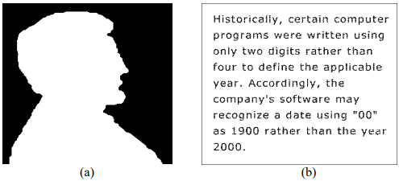
Binary images
Binary images are the simplest type of images and can take on two values, typically black and white, or 0 and 1. A binary image is referred to as a 1-bit image because it takes only 1 binary digit to represent each pixel. These types of images are frequently used in applications where the only information required is general shape or outline, for example optical character recognition (OCR). Binary images are often created from the gray-scale images via a threshold operation, where every pixel above the threshold value is turned white ('1'), and those below it are turned black ('0'). In the figure below, we see examples of binary images.

Slide 4
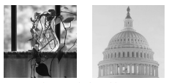
Gray Scale Images
Gray-scale images are referred to as monochrome (one-color) images. They contain gray-level information, no color information. The number of bits used for each pixel determines the number of different gray levels available. The typical gray-scale image contains 8bits/pixel data, which allows us to have 256 different gray levels. The figure below shows examples of gray-scale images. In applications like medical imaging and astronomy, 12 or 16 bits/pixel images are used. These extra gray levels become useful when a small section of the image is made much larger to discern details.

Slide 5
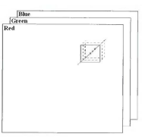
Color Images
Color images can be modeled as three-band monochrome image data, where each band of data corresponds to a different color. The actual information stored in the digital image data is the gray-level information in each spectral band. Typical color images are represented as red, green, and blue (RGB images). Using the 8-bit monochrome standard as a model, the corresponding color image would have 24-bits/pixel (8-bits for each of the three color bands red, green, and blue). The figure below illustrates a representation of a typical RGB color image.

Slide 6
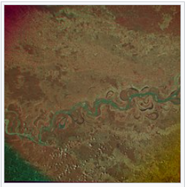
Multispectral Images
Multispectral images typically contain information outside the normal human perceptual range. This may include infrared, ultraviolet, X-ray, acoustic, or radar data. These are not images in the usual sense because the information represented is not directly visible by the human system. However, the information is often represented in visual form by mapping the different spectral bands to RGB components. It can allow extraction of additional information the human eye fails to capture with its visible receptors for red, green and blue. It was originally developed for military target identification and reconnaissance. Early space-based imaging platforms incorporated multispectral imaging technology

Slide 7

Two-Dimensional Images
A flat image that has only height and width (X and Y axis). It lacks depth, making it look flat, like a photograph or a drawing. Let’s imagine you’re looking at a drawing of a cat on a piece of paper. That’s a 2D image. “2D” means it’s flat, like when you draw on a sheet of paper or see a picture in a book. Everything you see in a 2D image has height and width, but it doesn’t have depth. It’s like looking at a painting; no matter how much you try, you can’t see behind the surface.

Slide 8
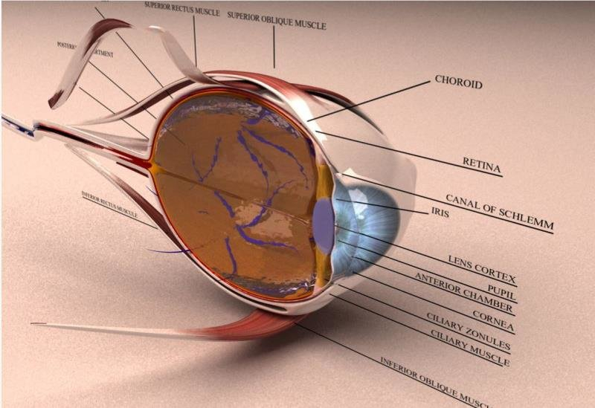
Three-Dimensional Images
Images that include depth along with height and width (X, Y, and Z axis), creating a perception of volume or space. A 3D image represents objects in three dimensions: height, width, and depth. Unlike 2D images, 3D images provide a perception of volume and space, allowing viewers to rotate and view the object from different angles. Commonly used in gaming, animation, virtual reality, and simulations, 3D images create more realistic and immersive visual experiences
3D human Eye Model

Slide 9
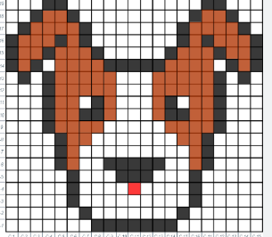
What is pixel in images?
A pixel (short for "picture element") is the smallest unit of a digital image or display. It represents a single point of color in a grid that makes up the entire image. Each pixel contains color information, typically in the form of RGB (Red, Green, Blue) values, which combine to create the final color. Key Points. Pixel Grid, Resolution, Zooming

Slide 10
How to decide pixels values?
Color Model: Use RGB values (Red, Green, Blue) ranging from 0 to 255. For example :
Red = (255, 0, 0)Black = (0, 0, 0)
Resolution: Higher resolution (more pixels) gives more detail. For example, 1920x1080 pixels for a Full HD image
Compression & Bit Depth: Compression (JPEG, PNG) and bit depth (8-bit, 24-bit) can affect pixel quality.

Slide 11
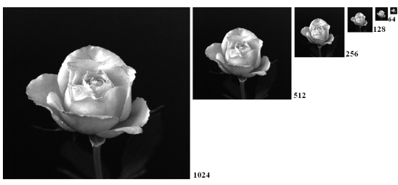
Gray scales levels
Refer to the range of shades of gray between black and white in an image. The levels are determined by the intensity values assigned to each pixel, where black is the lowest intensity and white is the highest intensity.
Common Gray Scale Levels.
2-bit Gray Scale: 4 levels (0, 1, 2, 3)
Can represent 4 shades of gray, including black and white
4-bit Gray Scale: 16 levels (0 to 15)
Can represent 16 shades of gray.
8-bit Gray Scale: 256 levels (0 to 255)
0 is black, 255 is white, and intermediate values are shades of gray
16-bit Gray Scale: 65,536 levels (0 to 65,535)
Offers extremely fine gradients of gray, used in high-quality imaging.

Slide 12
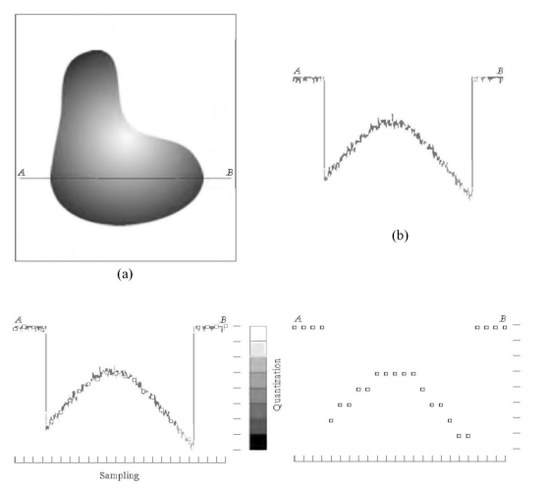
Image Sampling and Quantization
To convert the continuous function f(x,y) to digital form, we need to sample the function in both coordinates and in amplitude.
Digitizing the coordinate values is called sampling.
Digitizing the amplitude values is called quantization.
We show how to convert the continuous image in Figure to the digital form using the sampling and quantization processes. The one-dimensional function is a plot of amplitude (gray level) values of the continuous image along the line segment . To sample this function, we take equally spaced samples along line AB. The samples are shown as small white squares superimposed on the function. The set of these discrete locations gives the sampled function.

Slide 13
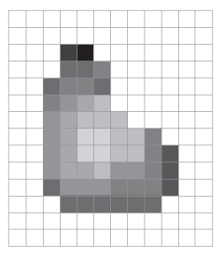
Digital Image resulted from sampling and quantization
The number of selected values in the sampling process is known as the image spatial resolution. This is simply the number of pixels relative to the given image area.
The number of selected values in the quantization process is called the grey-level (color level) resolution. This is expressed in terms of the number of bits allocated to the color levels.
The quality of a digitized image depends on the resolution parameters on both processes.

Slide 14
What is fundus image enhancement technique?
Fundus image enhancement techniques are methods used to improve the quality and visibility of images taken from the fundus (the interior surface of the eye) for better analysis and diagnosis of ocular diseases. These techniques are particularly useful in ophthalmology and optometry, where fundus images can reveal crucial information about conditions such as diabetic retinopathy, glaucoma, and age-related macular degeneration.
Contrast Enhancement
Noise Reduction
Edge Detection
Color Enhancement
Image Registration
Deep Learning Techniques
Retinal Layer Segmentation

Slide 15


